Slide 1


Community Partner: Future Ada
Rebecca Long | @amaya30 Future Ada, President & Founder | @futureada RiskLens, Lead DevOps Engineer | @risklens
ACTE Summer Conference 2019

Slide 2
Who is Future Ada?
Rebecca Long / Future Ada | @amaya30 / @futureada | ACTE 2019
Spokane based 501c3 non-profit advocating for women and non-binary individuals in STEAM (science, technology, engineering, art, & math)
Ultimate vision is to create a diverse & inclusive environment within all the STEAM fields
Founded in 2017
Received non-profit status in early 2018
Made up of a current 6 member board and a strong pool of volunteers

Slide 3

Why STEAM and not STEM?
Rebecca Long / Future Ada | @amaya30 / @futureada | ACTE 2019
Science, technology, engineering, art, and mathematics (STEAM) are the industries leading the charge into the future
Art brings creativity and inclusivity to STEM fields
Art pushes STEM professionals to think outside the box when problem solving

Slide 4
What are our values?

Slide 5
Inclusion
Representation
Diversity
Collaboration
Creativity
Innovation
Empowerment
Security
Rebecca Long / Future Ada | @amaya30 / @futureada | ACTE 2019

Slide 6
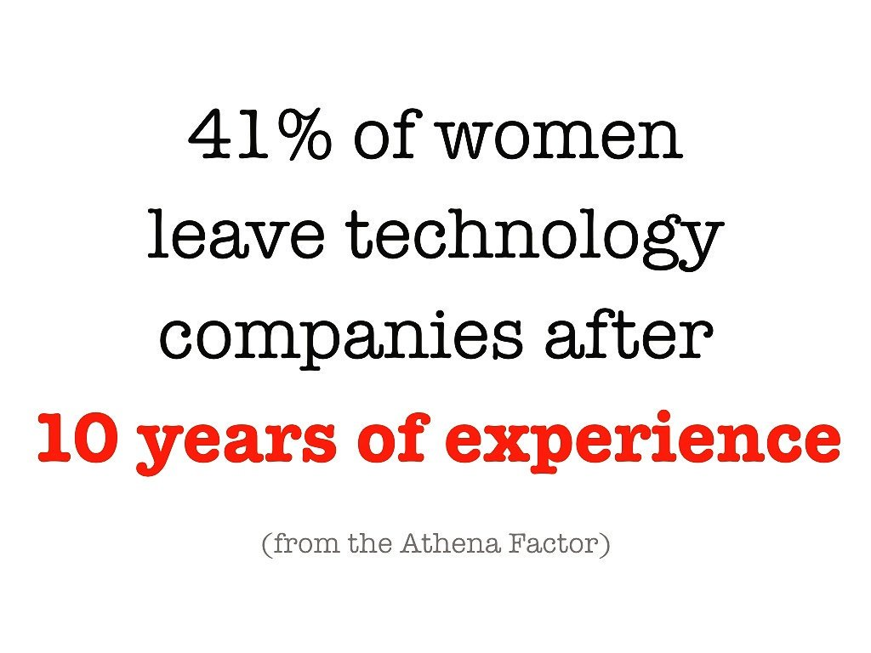
Why is an organization like this needed?
Rebecca Long / Future Ada | @amaya30 / @futureada | ACTE 2019

Slide 7
Why is an organization like this needed?
Rebecca Long / Future Ada | @amaya30 / @futureada | ACTE 2019
Founded to help bring support to gender minorities of all ages in the sciences and tech
Want to encourage and inspire young folks to consider STEAM fields for careers
Want to support those already in these fields so they feel welcomed to stay
The world is stronger when we are all at the problem solving table
No one should feel pushed out of a STEAM program or career before they choose to do so for their own reasons

Slide 8
Current community partnerships
Community Partners
Membership Associations
Inland Northwest Technologists
Volunteers of America Spokane
YWCA Spokane
Spark Central
Eastern Washington University Computer Science Professional Advisory Board
Spokane Community College Software Development Advisory Board
Spokane Public School District 81 IT Advisory Board
Electronic Frontier Alliance
Inland Northwest Business Alliance

Slide 9
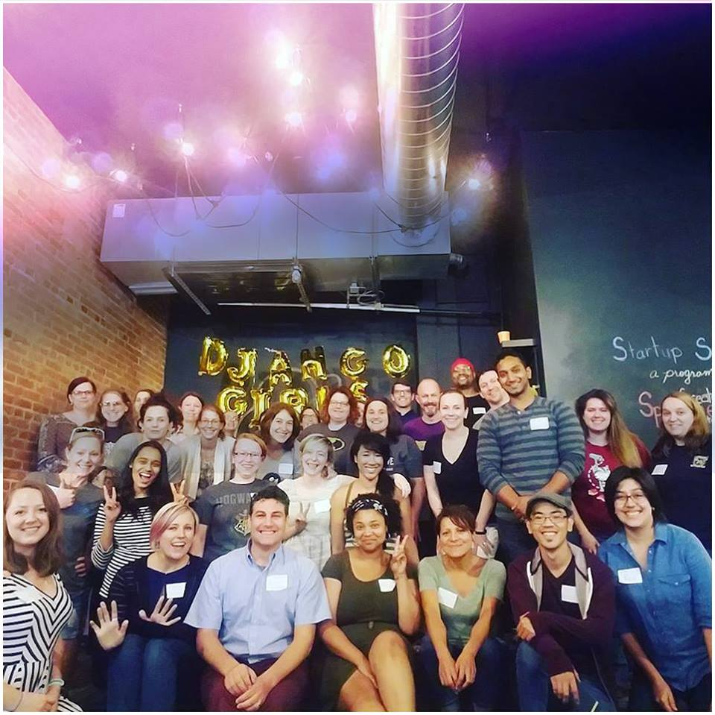
What programs do we offer?
Rebecca Long / Future Ada | @amaya30 / @futureada | ACTE 2019
Privacy & Security Workshop
Django Girls
Code in the Dark
March for Science Spokane
Career Mentor Program
Women in Tech Interview Workshop

Slide 10

Connect with us!
Rebecca Long / Future Ada | @amaya30 / @futureada | ACTE 2019
Rebecca Long
https://rebeccalong.tech
Social: @amaya30
Future Ada
hello@futureada.org
https://futureada.org
Social: @futureada

